Slide 1


#WiDS2019

Slide 2
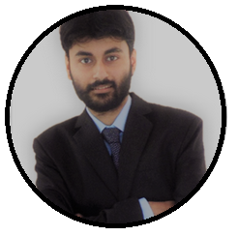
Name: Rahul Mitra
Work Experience: 4.7 years of experience in Data Science and Software development.
Current Organization: Lead Data Sciences in Envestnet | Yodlee
Previous Organizations: IBM Software Lab, TCS
Academics: M.Tech in IT from IIT Kharagpur.
Achievement: Won 3 hackathons with my team during my time in IBM
Skills: Machine Learning, Deep Learning, Java, Python
Hobby: Sports enthusiast.

Slide 3
Contents
Basic steps
Code walkthrough on CNN
Introduction to Kaggle
Workflow in Kaggle
Top 5 points to succeed in Kaggle

Slide 4
Steps to solve a problem with data science
Problem Statement
Explore data
Data Preprocessing
Feature Engineering
Apply ML Algorithm
Yes
Need changes as per feedback?
Retrain required?
Final Delivery
No
Yes
Do necessary changes
Deploy
No
Performance Evaluation

Slide 5
Code walkthrough of building CNN on Fruits dataset
Fruits dataset have images for 95 categories of fruits.
In the demo we will see image classification between these using CNN.

Slide 6
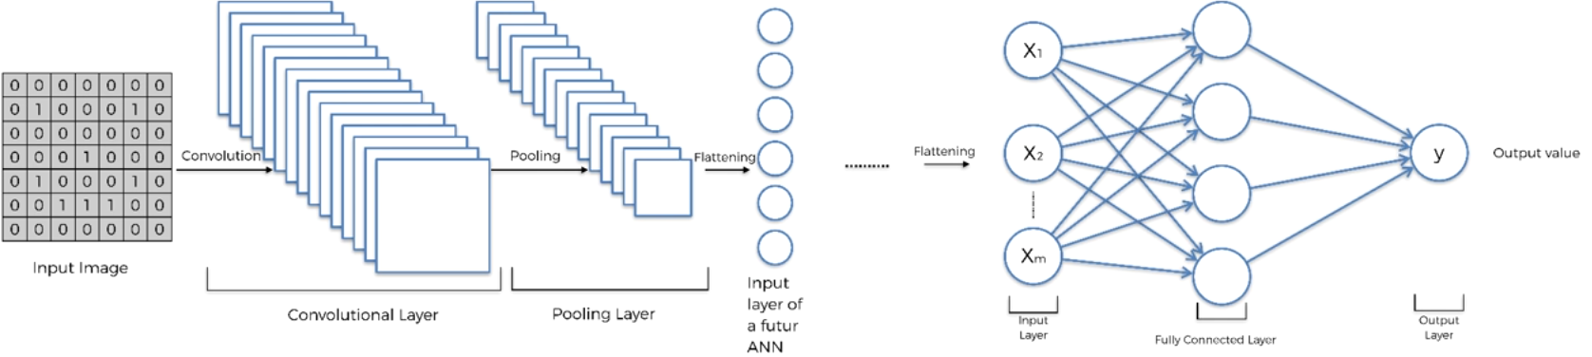
Code walkthrough of building CNN on Fruits dataset Contd..
https://github.com/rahulmitra-kgp/cnn_build_stepwise

Slide 7
Introduction to Kaggle

Slide 8
Workflow in Kaggle
Data
Model
Submission
Evaluation
Leaderboard

Slide 9
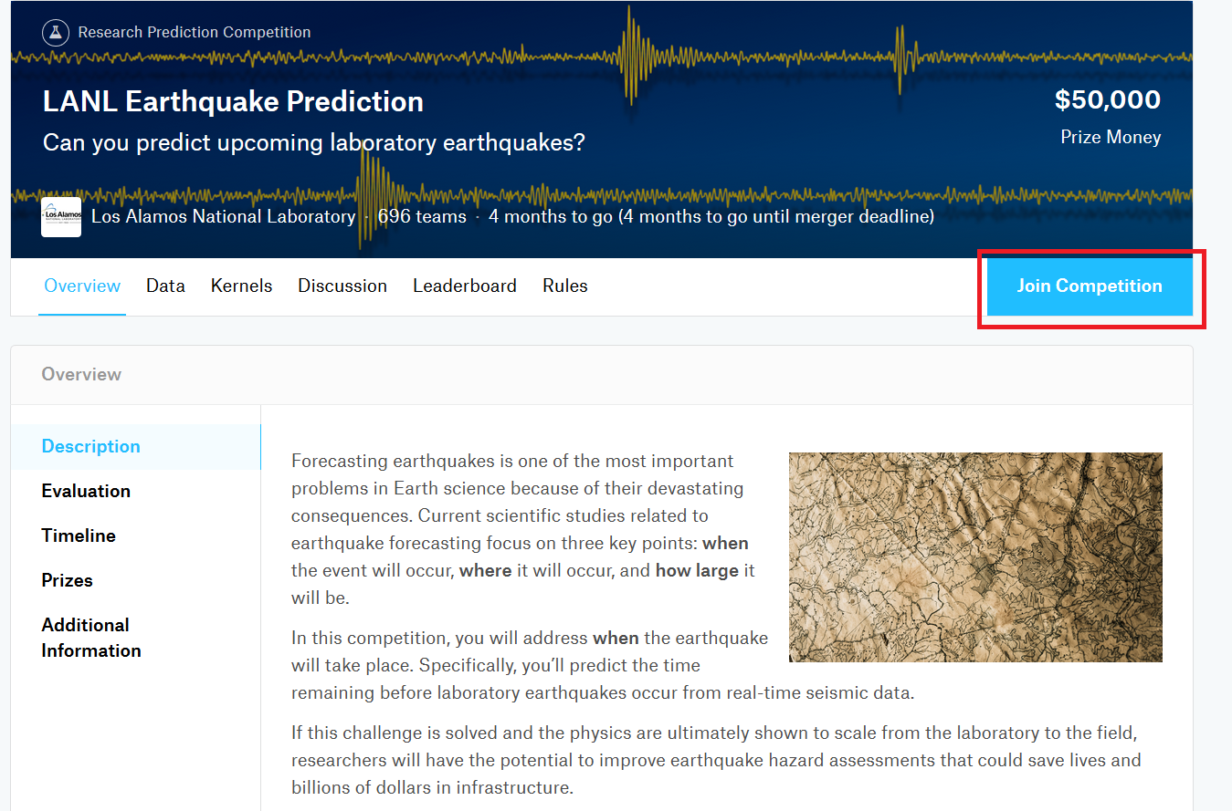
Joining a competition
https://www.kaggle.com

Slide 10
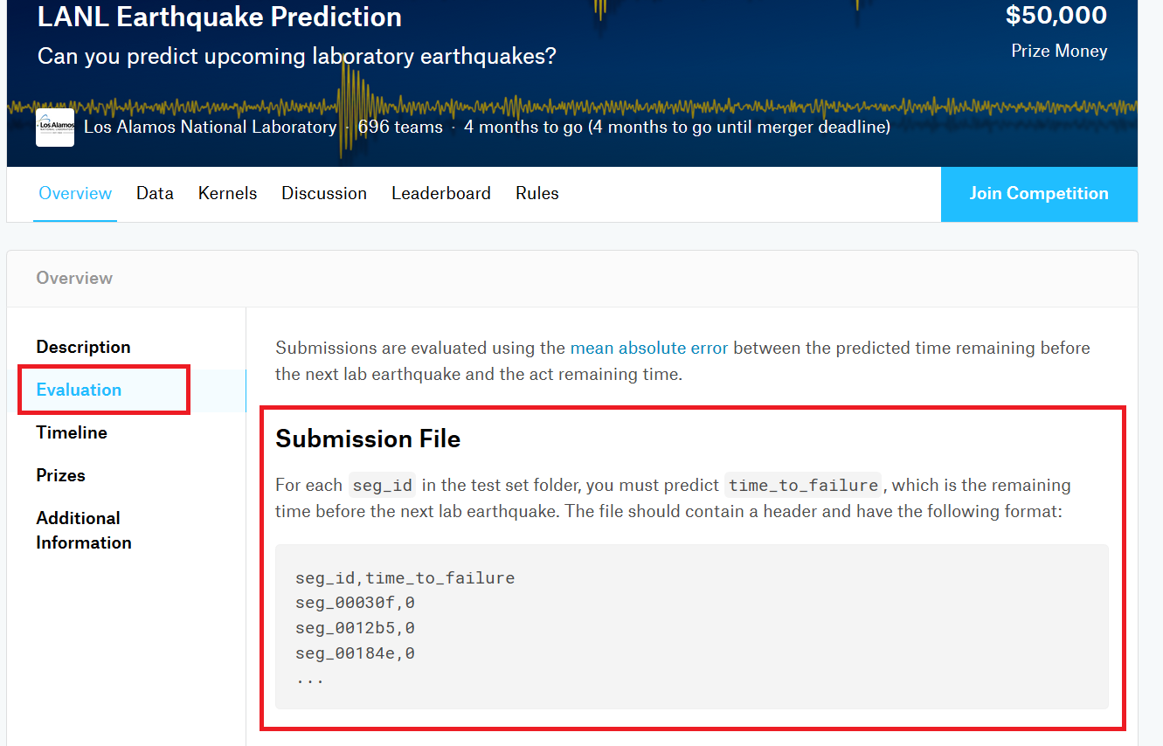
Evaluation metric

Slide 11
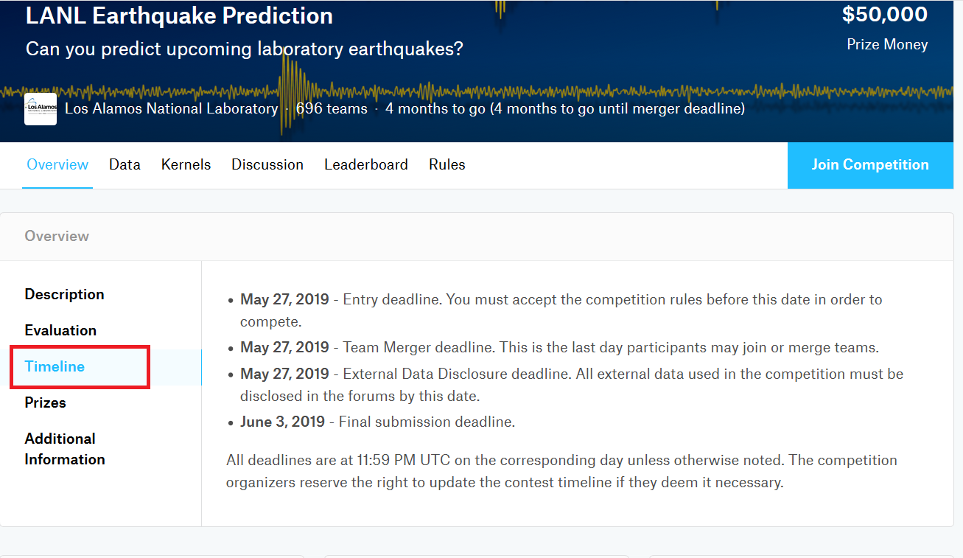
Competition timeline

Slide 12
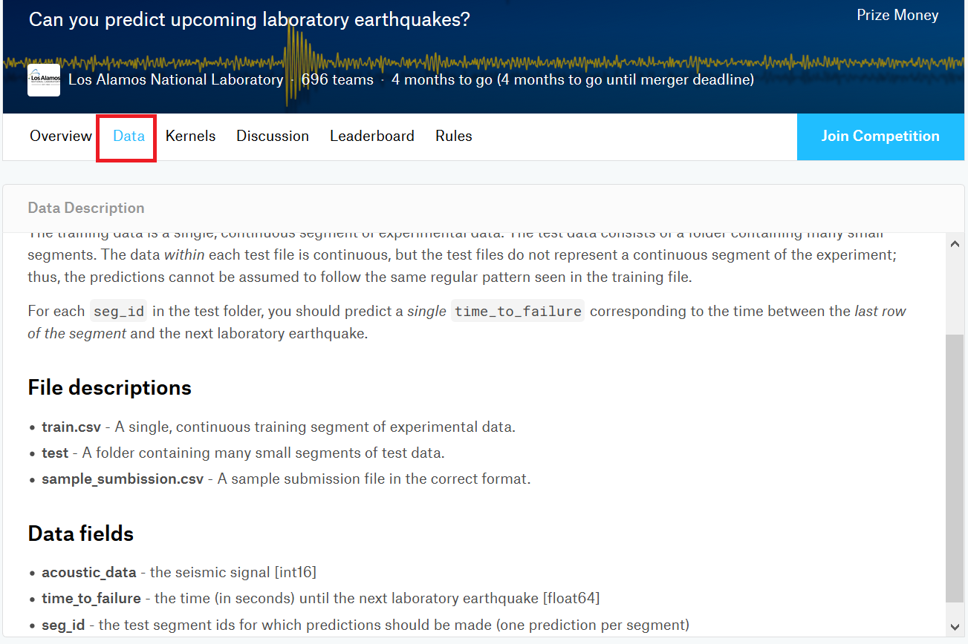
Dataset for the competition

Slide 13
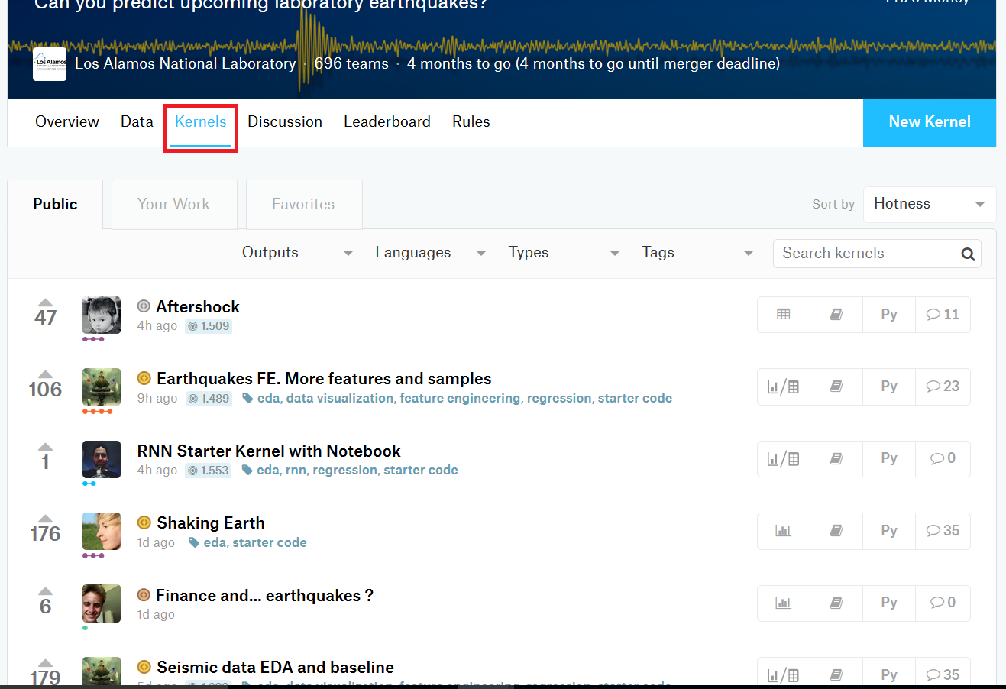
Kernel

Slide 14
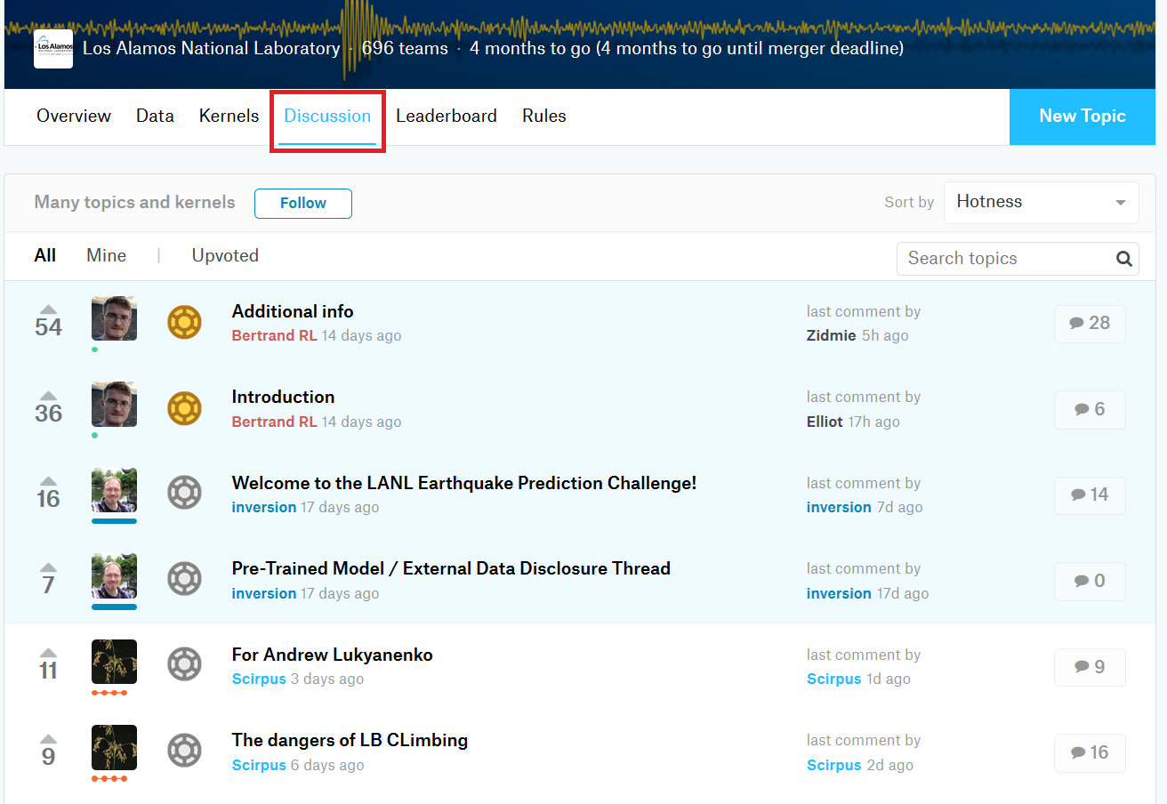
Discussion

Slide 15
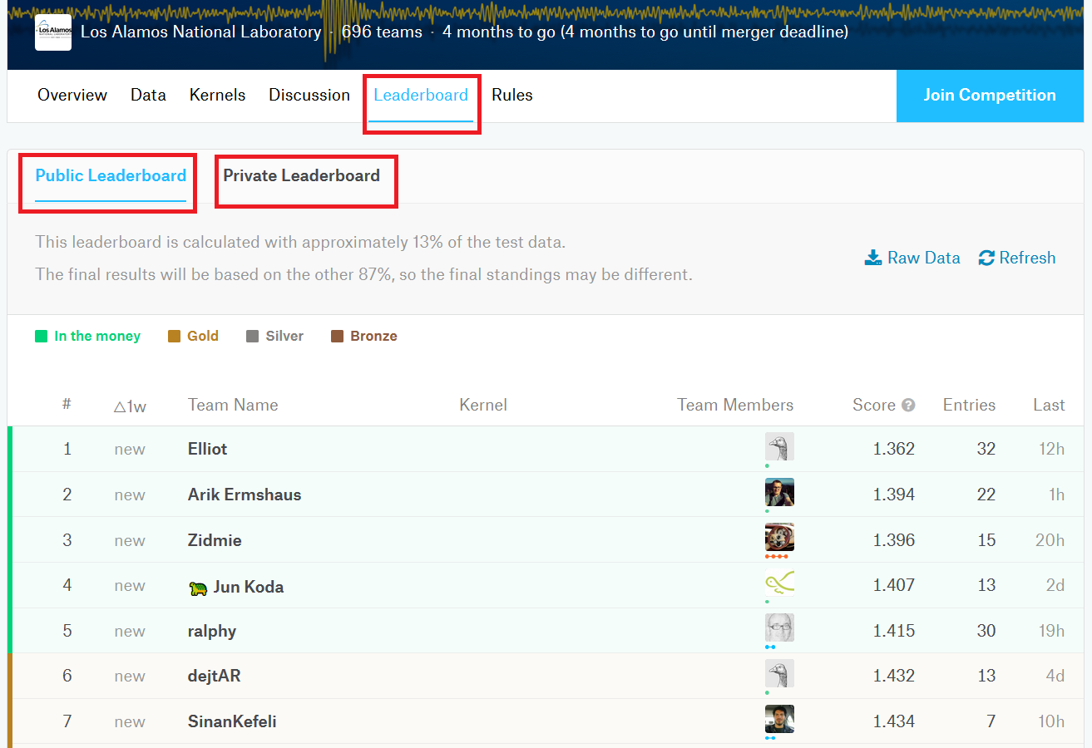
Leaderboard

Slide 16
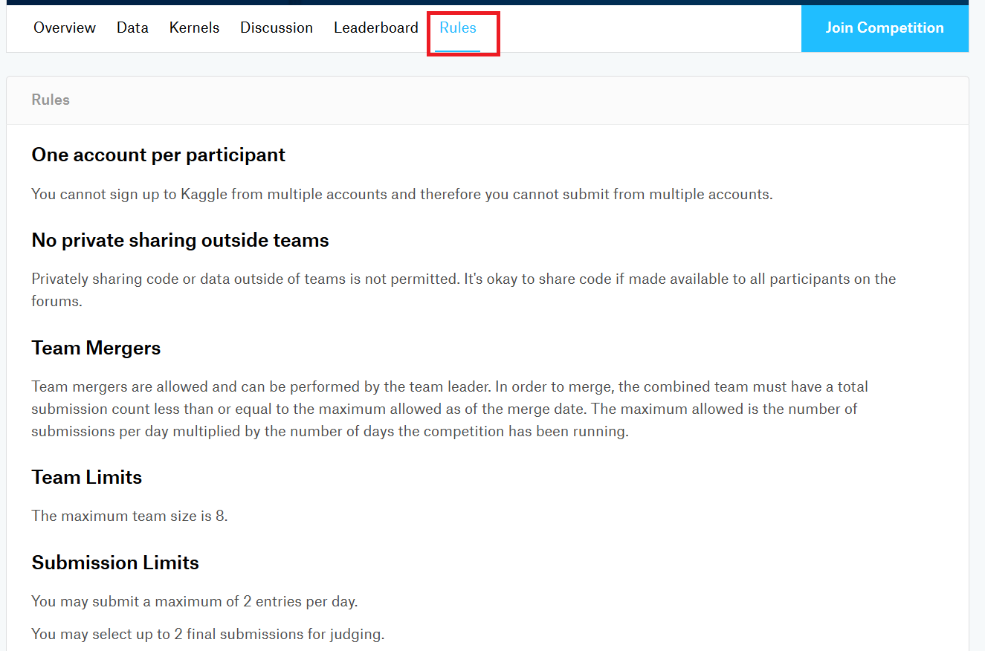
Rules

Slide 17
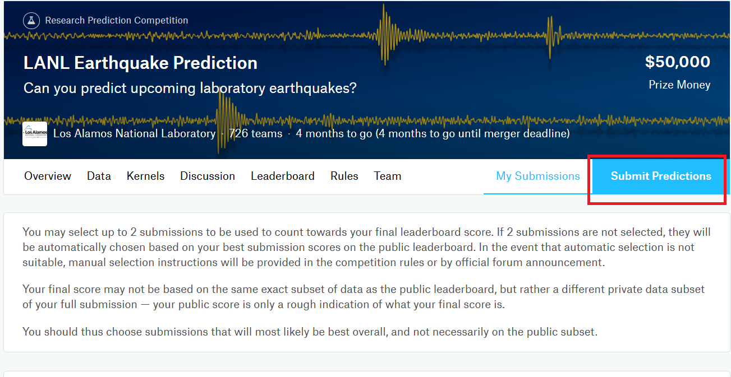
Submission

Slide 18
Top 5 points to succeed in Kaggle
Data preparation is very important and often takes considerable time.
Special focus should be given on feature engineering.
Domain knowledge in the specific field is crucial.
Try tuning the hyper-parameters in the ML algorithm.
Use a good validation set for evaluation.

Slide 19
Question?

Slide 20
Thank You

